Slide 1
Gabor filters and its applications for emotion detection.
Mohneesh Khaneja -IIT2014041
Prateek Agarwal - IIT2014068
Shivam - IIT2014077
Pratik Mangalore - IIT2014112

Slide 2
Introduction
Initially we took a dataset Jaffe in which we have 213 images representing 7 different emotions. We applied gabor filter over each image in 16 different orientation and 5 different wavelength giving us 80 features per image.We then used K Nearest Neighbour Classifier to classify the test image into one of the seven class.Ten percent of the data present in the dataset was used as Test Image and remaining 90 percent was used as Training Data. The final objective of classifying the given face image to one of the seven emotion was achieved with 83 percent accuracy.

Slide 3
Challenges
In emotional recognition of face a notable advancement has been observed in the field of neuroscience, cognitive and computational intelligence. It is also proved by Kharat and Dudul that about 55% effect of overall emotion expression is as facial expression which is contributed during social interactions.
Actually, facial muscle generates monetary adaptation in facial appearance which can be recapitulated by incorporating Action Units. The six common emotions have been considered as globally recognizable as the movements of muscle are very similar of these emotional expressions from the people from various region and society. Therefore, we have mainly concentrated on the automatic recognition of these six fundamental emotions. In general, emotion recognition is a two steps procedure which involves extraction of significant features and classification. Feature extraction determines a set of independent attributes, which together can portray an expression of facial emotion.
For classification in emotion recognition the features are mapped into either of various emotion classes like anger, happy, sad, disgust, surprise, etc.
For the effectiveness calculation of a facial expression identification model both the group of feature attributes which have been taken for feature extraction and the classifier that is responsible classification are equivalently significant. For a badly picked collection of feature attributes, in some cases, even a smart classification mechanism is not able to produce an ideal outcome.
Thus, for getting the high classification accuracy and qualitative outcome, picking of superior features will play a major role.
Current state of the art techniques for emotion detection use Deep Convolutional Neural Network. The standard datasets, i.e. Extended Cohn-Kanade (CKP) and MMI Facial Expression Database were used for the quantitative evaluation in state of the art techniques. On the CKP set the current state of the art approach, using CNNs, achieves an accuracy of 99.2%. For the MMI dataset, currently the best accuracy for emotion recognition is 93.33% [0]

Slide 4
Objective
The main objective of this project is to classify the human faces based on their facial expressions which basically convey emotions. To do so we used Gabor Filter to extract features and supervised machine learning algorithm to classify.
We have considered seven classes with each class representing an emotion. Initially we have taken 5 fold crossover which is a classification technique that involves us splitting the dataset into 5 regions where each region is taken as the test data, other regions being training data, and this is repeated for every region. Gabor filter is applied to each of the training folds and we generate 80 features which in total occupy 213*768 bytes of memory . Then using KNN we classified the test data into one of the seven classes.

Slide 5
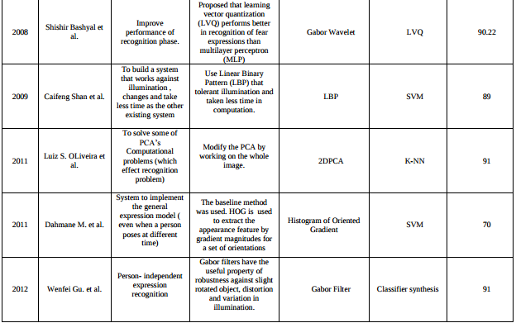
Literature Survey

Slide 6
Research group Working
Visual Geometry Group (University of Oxford) http://www.robots.ox.ac.uk/~vgg/research/texclass/filters.html
Machine Vision and Pattern Recognition Research Group(Lappeenranta University of Technology) http://www.it.lut.fi/project/gabor/
Institute for Computer Graphics and Vision, Graz University of Technology

Slide 7
Commercial Utility
We can extract faces from live streaming videos and detect their emotions as our code is much more faster than Deep Neural Networks.

Slide 8
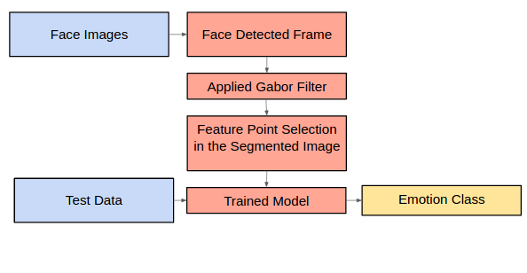
Proposed Approach
The methodology of the whole application is subdivided into 3 broad and independent modules as described below:-

Slide 9
Feature Extraction
Gabor Filter was used to extract feature map for every image by varying the parameters such as lambda , theta , sigma , gamma psi and so for every given image 80 Responses were collected which in aggregation acted as a single feature map. These 80 responses were collected by varying theta across 16 values and lambda (wavelength) across 5 values.
The intuition behind the same is explained below:-
Theta is the most important attribute passed to the gabor filter constructing function. Whenever we express our emotions our eyebrows, eyes and lips tilt at certain angles, where higher tilt angles usually denotes a more intense emotion. Each of the theta passed to the function captures a certain intensity of the emotion and hence we have taken 16 possible values of theta in order to obtain a good balance of depth and contrast in images.
Lambda basically tells us the wavelength of the sinusoidal wave which is convolved with the gaussian function to ultimately create the gabor filter. Higher the value of lambda, less will be the effect of the sinusoid on the gaussian and hence the gabor filter will be smoother and the response with the image will also have less contrast. Lower values of lambda will capture even subtle changes in the image, such as brow furrows and shadows.
Gamma controls the ellipticity of the gaussian. When gamma = 1, the gaussian envelope is circular.
Psi controls the phase offset of the sinusoidal wave.

Slide 10
Dimensionality Reduction
Since for every image 80 Responses were collected and every image was of the size 256 * 256 , the feature map was of huge size. Therefore dimensionality reduction was done by extracting only the face out of the images. This effectively sped up the process by approximately 4 times and also reduced the space complexity by about half.

Slide 11
Classification
Once the dimensionality reduced feature maps are obtained , these are used to train the model for all the emotions present in the images and map a label for every given face image.

Slide 12
Hardware and Software Requirements
1 GB RAM
Python
OpenCV
Weka
MatplotLib
Scipy
Scikit-Learn
Numpy

Slide 13
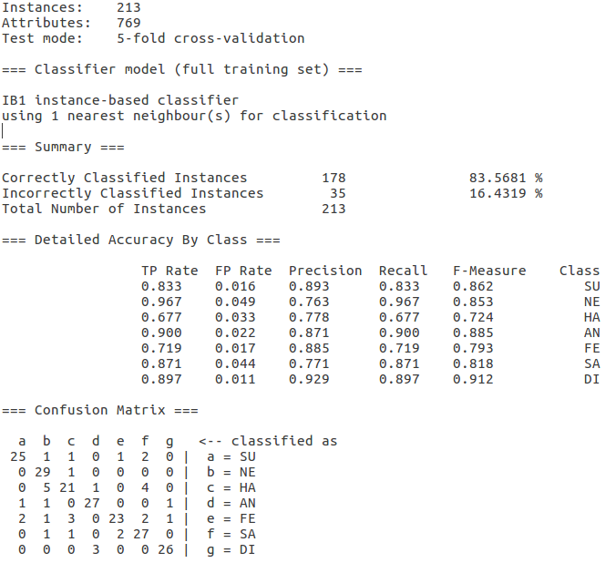
Result and Analysis
Performance Comparison
K Nearest Neighbour
Correctly Classified Instances 178 83.5681%
Incorrectly Classified Instances 35 16.4319%
RandomForest
Correctly Classified Instances 150 70.4225 %
Incorrectly Classified Instances 63 29.5775 %
Support Vector Machine
Correctly Classified Instances 159 74.6479 %
Incorrectly Classified Instances 54 25.3521 %

Slide 14
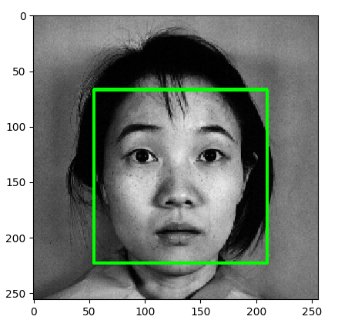
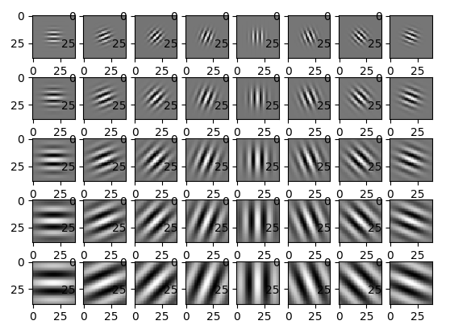
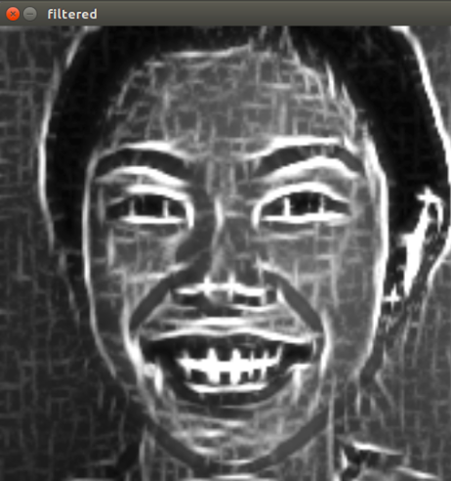
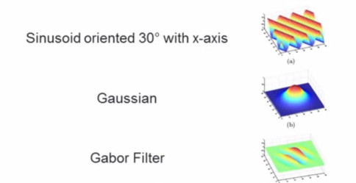
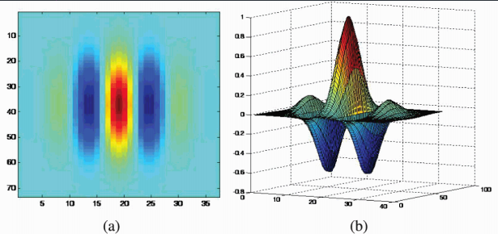
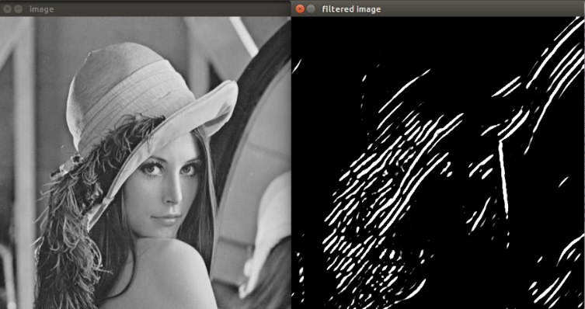
Screenshots

Slide 15
References
[1] Debishree Dagar, Abir Hudait,H. K. Tripathy,M. N. Das “Automatic Emotion Detection Model from Facial Expression” in International Conference on Advanced Communication Control and Computing Technologies 2016.
[2 Shruti Karkra , Jagandeep Kaur “Compound Facial Expression Recognition through Gabor Filter and RBF Network “ in International Journal of Computer Science and Mobile Computing 2016.

